Slide 1
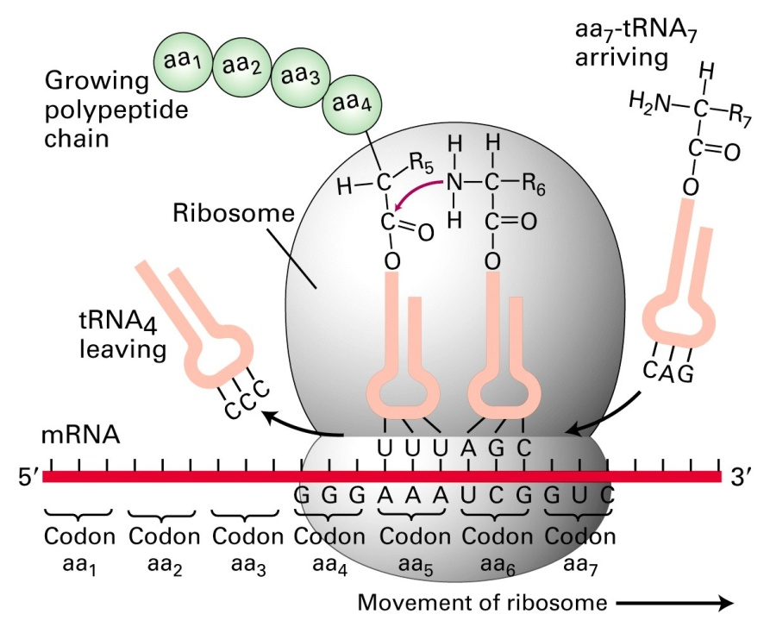
Basic Molecular Biology

Slide 2
Overview
Structures of biomolecules
How does DNA function?
What is a gene?
Computer scientists vs Biologists

Slide 3
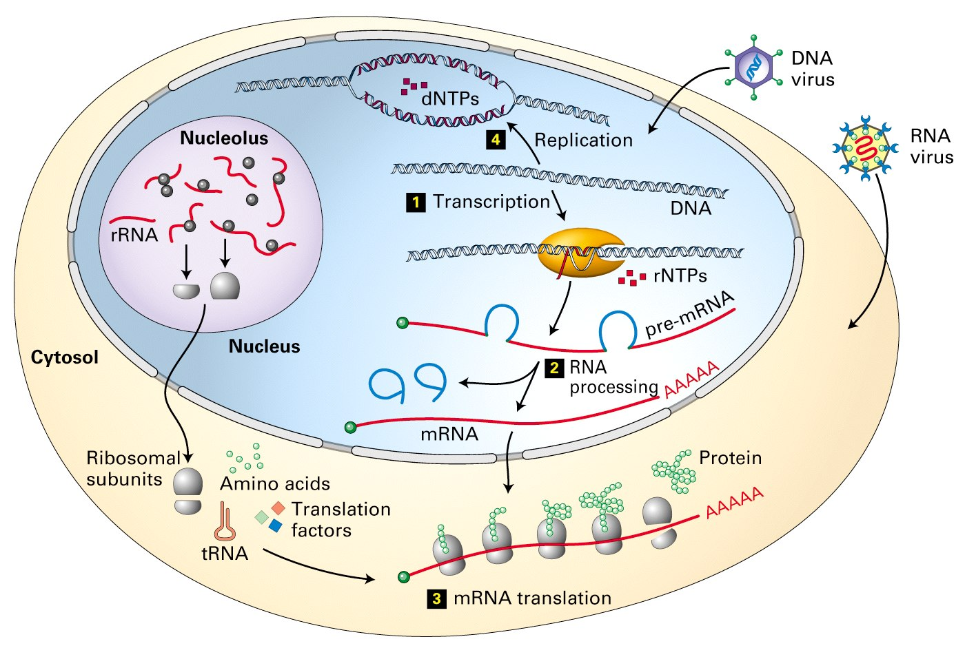
Bioinformatics schematic of a cell

Slide 4
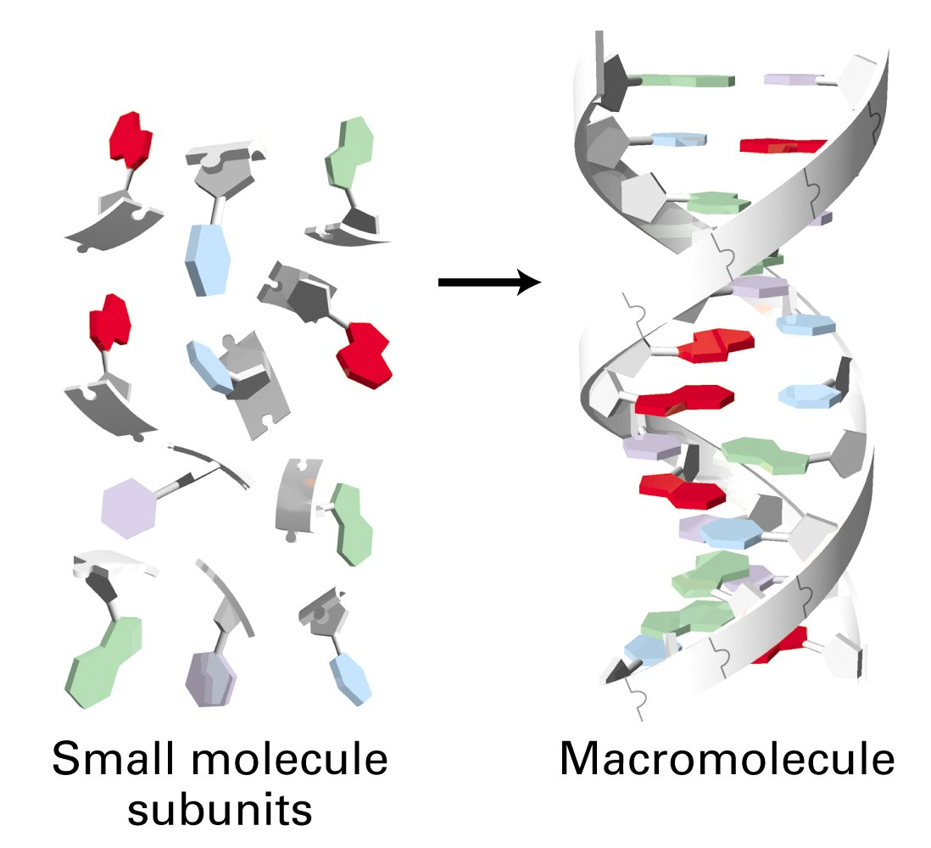

Slide 5
Macromolecule (Polymer) | Monomer
DNA | Deoxyribonucleotides (dNTP)
RNA | Ribonucleotides (NTP)
Protein or Polypeptide | Amino Acid

Slide 6
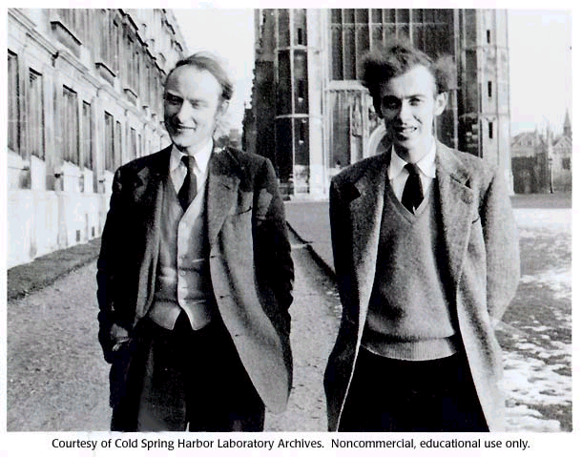
Watson and Crick
Notes:
They conducted no laboratory experiments but managed to guess the sum by analyzing its parts.
One of the greatest achievements of the 20th century

Slide 7
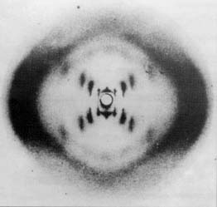
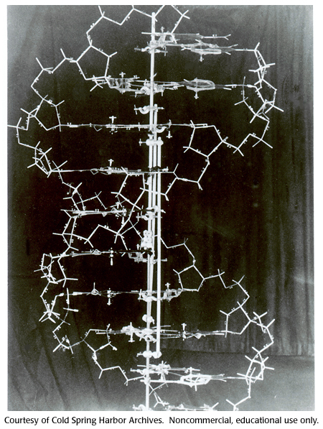
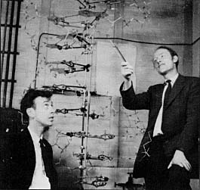

Slide 8
Nucleic acids (DNA and RNA)
Form the genetic material of all living organisms.
Found mainly in the nucleus of a cell (hence “nucleic”)
Contain phosphoric acid as a component (hence “acid”)
They are made up of nucleotides.

Slide 9
Nucleotides
A nucleotide has 3 components
  Sugar (ribose in RNA, deoxyribose in DNA)
  Phosphoric acid
  Nitrogen base
    Adenine (A)
    Guanine (G)
    Cytosine (C)
    Thymine (T) or Uracil (U)

Slide 10
Monomers of DNA
A deoxyribonucleotide has 3 components
  Sugar - Deoxyribose
  Phosphoric acid
  Nitrogen base
    Adenine (A)
    Guanine (G)
    Cytosine (C)
    Thymine (T)

Slide 11
Monomers of RNA
A ribonucleotide has 3 components
  Sugar - Ribose
  Phosphoric acid
  Nitrogen base
    Adenine (A)
    Guanine (G)
    Cytosine (C)
    Uracil (U)

Slide 12
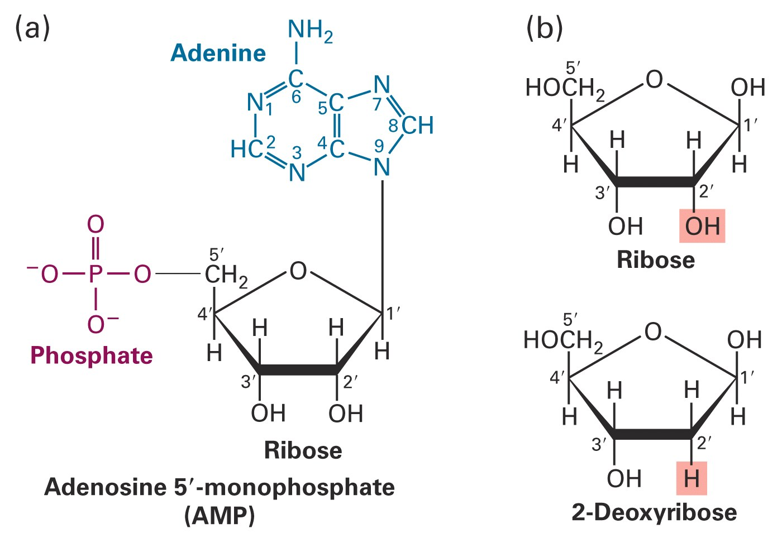

Slide 13
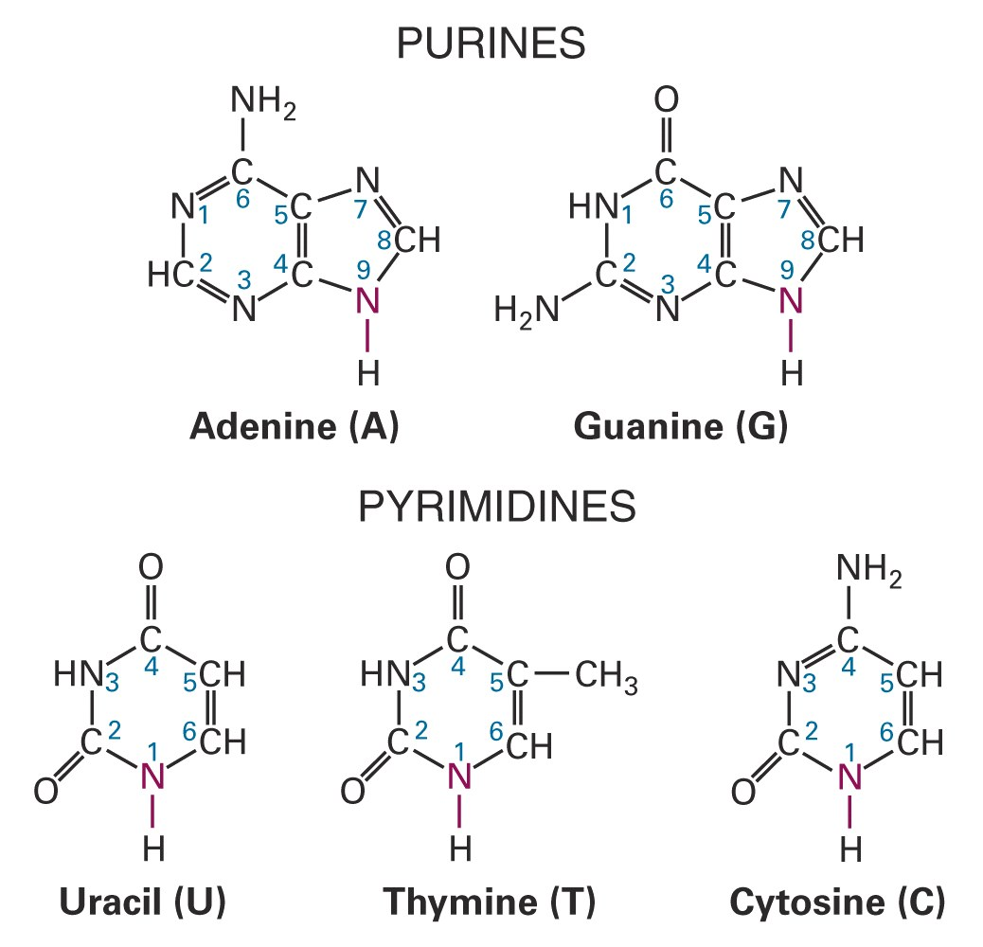

Slide 14
Nucleotides
Nitrogenous
Base
Phosphate
Group
Sugar
Nitrogenous
Base
Phosphate
Group
Sugar

Slide 15

DNA
RNA
A
T
A
A = T
G = C
G
C
G
C
G
C
G
C
G
A
T
A
C
G
T → U
C
T
A
U
G
C
G

Slide 16
Proteins
Composed of a chain of amino acids.
R
|
H₂N--C--COOH
|
H
20 possible groups

Slide 17
Proteins
R R
| |
H₂N--C--COOH H₂N--C--COOH
| |
H H

Slide 18
Dipeptide
This is a peptide bond
R O R
| II |
H₂N--C--C--NH--C--COOH
| |
H H

Slide 19
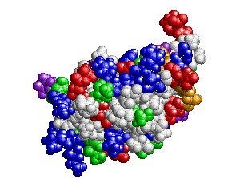
Protein structure
Linear sequence of amino acids folds to form a complex 3-D structure.
The structure of a protein is intimately connected to its function.

Slide 20
Structure -> Function
It is the 3-D shape of proteins that gives them their working ability – generally speaking, the ability to bind with other molecules in very specific ways.

Slide 21
DNA in action
Questions about DNA as the carrier of genetic information:
  How is the information stored in DNA?
  How is the stored information used ?
Answers:
  Information is stored as nucleotide sequences.
  .. and used in protein synthesis.

Slide 22
How does the series of chemical bases along a DNA strand (A/T/G/C) come to specify the series of amino acids making up the protein?

Slide 23
The need for an intermediary
Fact 1 : Ribosomes are the sites of protein synthesis.
Fact 2 : Ribosomes are found in the cytoplasm.
Question : How does information ‘flow’ from DNA to protein?

Slide 24
The Intermediary
Ribonucleic acid (RNA) is the “messenger”.
The “messenger RNA” (mRNA) can be synthesized on a DNA template.
Information is copied (transcribed) from DNA to mRNA. (TRANSCRIPTION)

Slide 25
Transcription
The DNA is contained in the nucleus of the cell.
A stretch of it unwinds there, and its message (or sequence) is copied onto a molecule of mRNA.
The mRNA then exits from the cell nucleus.
Its destination is a molecular workbench in the cytoplasm, a structure called a ribosome.

Slide 26
Next question…
How do I interpret the information carried by mRNA?
Think of the sequence as a sequence of “triplets”.
Think of AUGCCGGGAGUAUAG as AUG-CCG-GGA-GUA-UAG.
Each triplet (codon) maps to an amino acid.

Slide 27
The Genetic Code
f : codon → amino acid
1968 Nobel Prize in medicine – Nirenberg and Khorana
Important – The genetic code is universal!
It is also redundant / degenerate.

Slide 28
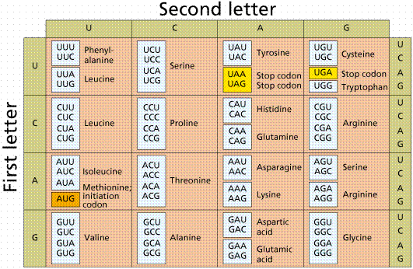
The Genetic Code

Slide 29
At the ribosome, both the message (mRNA) and raw materials (amino acids) come together to make the product (a protein).

Slide 30
Translation
The sequence of codons is translated to a sequence of amino acids.
How do amino acids get to the ribosomes?
  They are brought there by a second type of RNA, transfer RNA (tRNA).

Slide 31
Translation
Transfer RNA (tRNA) – a different type of RNA.
  Freely float in the cytoplasm.
  Every amino acid has its own type of tRNA that binds to it alone.
Anti-codon – codon binding crucial.

Slide 32
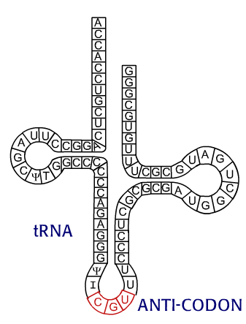
tRNA

Slide 33
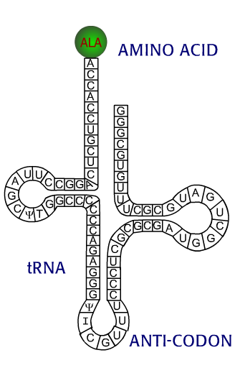
tRNA
One end of the tRNA links with a specific amino acid, which it finds floating free in the cytoplasm.
It employs its opposite end to form base pairs with nucleic acids – with a codon on the mRNA tape that is being read inside the ribosome.

Slide 34
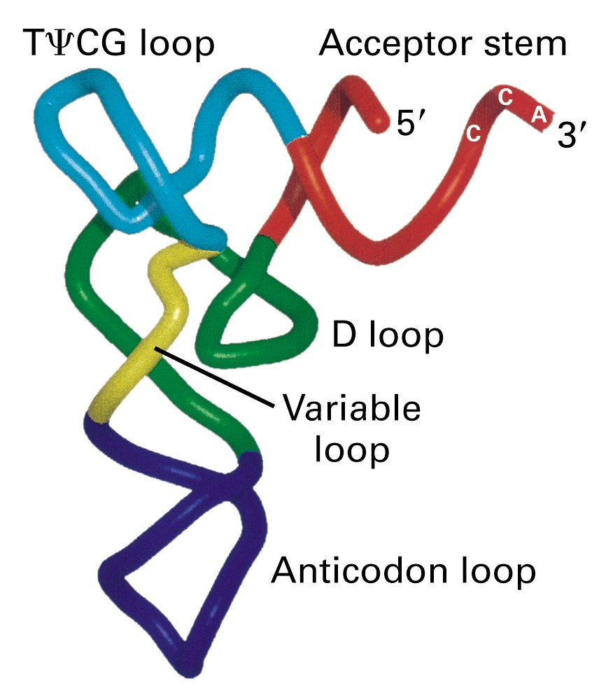
tRNA

Slide 35
The gene and the genome
A gene is a length of DNA that codes for a protein.
Genome = The entire DNA sequence within the nucleus.

Slide 36
More complexity
The RNA message is sometimes “edited”.
Exons are nucleotide segments whose codons will be expressed.
Introns are intervening segments (genetic gibberish) that are snipped out.
Exons are spliced together to form mRNA.

Slide 37
Splicing
frgjjthissentencehjfmkcontainsjunkelm
thissentencecontainsjunk

Slide 38
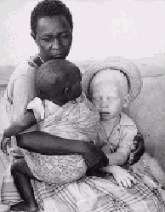
Central Dogma of Molecular Biology
DNA → RNA → Protein → Phenotype
Transcription : DNA → RNA
Translation : RNA → Protein

Slide 39

Central dogma
ZOOM IN
tRNA
transcription
DNA
rRNA
snRNA
translation
mRNA
POLYPEPTIDE

Slide 40
Transcription – key steps
DNA
Initiation
Elongation
Termination
DNA
+
RNA

Slide 41
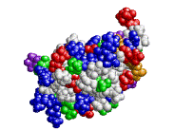
Transcription – key steps
DNA
Initiation
Elongation
Termination

Slide 42
Transcription – key steps
DNA
Initiation
Elongation
Termination

Slide 43
Transcription – key steps
DNA
Initiation
Elongation
Termination

Slide 44
Transcription – key steps
DNA
Initiation
Elongation
Termination
DNA
+
RNA

Slide 45
RNA polymerase
It is the enzyme that brings about transcription by going down the line, pairing mRNA nucleotides with their DNA counterparts.

Slide 46
Promoters
Promoters are sequences in the DNA just upstream of transcripts that define the sites of initiation.
The role of the promoter is to attract RNA polymerase to the correct start site so transcription can be initiated.
Promoter
5’
3’

Slide 47
Promoters
Promoters are sequences in the DNA just upstream of transcripts that define the sites of initiation.
The role of the promoter is to attract RNA polymerase to the correct start site so transcription can be initiated.
Promoter
5’
3’

Slide 48
Promoter
So a promoter sequence is the site on a segment of DNA at which transcription of a gene begins – it is the binding site for RNA polymerase.

Slide 49
Computer Scientists vs Biologists
(courtesy Steven Skiena, SUNY Stony Brook)

Slide 50
Computer scientists vs Biologists
(Almost) Nothing is ever completely true or false in Biology.
Everything is either true or false in computer science.

Slide 51
Computer scientists vs Biologists
Biologists strive to understand the very complicated, very messy natural world.
Computer scientists seek to build their own clean and organized virtual worlds.

Slide 52
Computer scientists vs Biologists
Biologists are more data driven.
Computer scientists are more algorithm driven.
One consequence is CS www pages have fancier graphics while Biology www pages have more content.

Slide 53
Computer scientists vs Biologists
Biologists are obsessed with being the first to discover something.
Computer scientists are obsessed with being the first to invent or prove something.

Slide 54
Computer scientists vs Biologists
Biologists are comfortable with the idea that all data has errors.
Computer scientists are not.

Slide 55
Computer scientists vs Biologists
Computer scientists get high-paid jobs after graduation.
Biologists typically have to complete one or more post-docs...

Slide 56
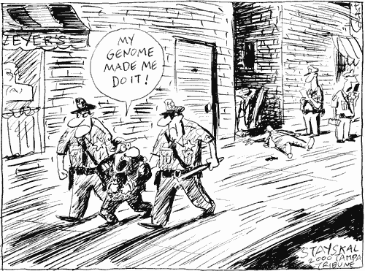
Computer Science is to Biology what Mathematics is to Physics

